Slide 1
C Programming

Slide 2
Contents
Introduction to C
Data Types
Operators

Slide 3
Introduction to C
General purpose language
High-level language
Developed by Dennis Ritchie

Slide 4
The C Compilation Model

Slide 5
C Preprocessor
Text substitution tool
Instructs compiler for preprocessing
Preprocessor commands begin with ‘#’ (hash) symbol

Slide 6
Preprocessor Commands
#define - Substitutes a preprocessor macro
#include - Inserts another file
Example:
#define MAX_ARRAY_LENGTH 20
#include<stdio.h>

Slide 7
Header Files
.h files
C function declarations & macrodefinitions
2 types:
User header files → Eg:- #include“file”
System header files → Eg:- #include<file>

Slide 8
Header Files - Example
#include<stdio.h>
Standard input output functions - printf(), scanf()
#include<math.h>
Mathematical functions - sqrt()
#include<string.h>
String handling functions - strcmp()

Slide 9
Input Output Functions
printf()
Example:
printf(“Hello World”\n);
scanf()
Example:
scanf(“%d”,&n);

Slide 10
C Syntax
#include inserts another file. “.h” files are called “header” files. They contain stuff needed to interface to libraries and code in other “.c” files.
This is a comment. The compiler ignores this.
#include <stdio.h>
/* The simplest C Program */
Void main( )
{
printf(“Hello World\n”);
return 0;
}
The main() function is always where your program starts running.
Blocks of code (“lexical scopes”) are marked by { … }
Return ‘0’ from this function
Print out a message. ‘\n’ means “new line”.
10

Slide 11
Algorithms
Sequence of steps to solve a problem by computer
Example:-
To find the sum, average and product of 3 numbers
Read X, Y, Z
Compute Sum (S) as X + Y + Z
Compute Average (A) as S / 3
Compute Product (P) as X x Y x Z

Slide 12
Flow Chart
Graphical or Symbolic representation of algorithm
Step 1: Input W,L
Step 2: A ← L x W
Step 3: Print A
START
Input
W, L
A ← L x W
Print
A
STOP

Slide 13
Data Types
Identify the type of a variable when it declared
Identify the type of the return value of a function
Identify the type of a parameter expected by a function
4 types:
Basic types
Enumerated types
Void type
Derived type

Slide 14
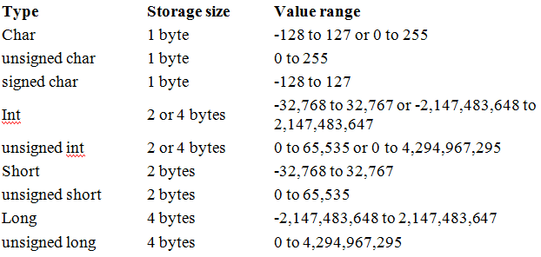
1. Basic Types
Integer types

Slide 15
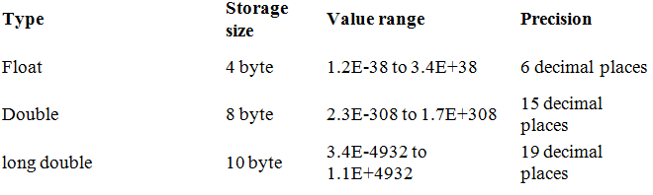
Basic Types(Cont..)
Floating-point types

Slide 16
Basic Types - Example
#include<stdio.h>
void main( )
{
int a, b; //variable declaration
int c;
float f;
a = 10; // initialization
b = 20;
c = a + b;
printf("value of c : %d \n”, c);
}
Output: value of c: 30

Slide 17
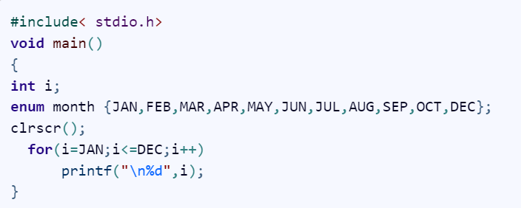
2. Enumerated types
assign certain discrete integer values
Output: 01234567891011

Slide 18
3. Void Type
Function returns as void
Eg:- void exit (int status);
Function arguments as void
Eg:- int rand(void);
Pointers to void
Eg:- void *malloc(size_t size)

Slide 19
Void Type - Example
void printmsg(void);
main()
{
/* print a message */
printmsg();
}
/* Function prints a message. */
void printmsg(void)
{
printf("****HOME IS WHERE THE HEART
IS****\n");
}

Slide 20
4. Derived Types
Pointer types
Array types
Structure types
Union types
Function types

Slide 21
Operators
Arithmetic operators
Relational operators
Logical operators
Bitwise operators
Assignment operators
Misc operators

Slide 22
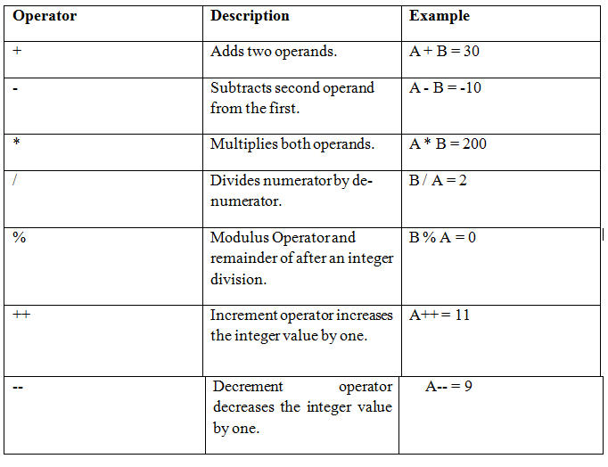
1. Arithmetic Operators

Slide 23
Arithmetic Operators - Example
#include <stdio.h>
main()
{
int a = 21;
int b = 10;
int c ;
c = a + b;
printf("Line 1 - Value of c is %d\n", c );
c = a - b;
printf("Line 2 - Value of c is %d\n", c );
c = a * b;

Slide 24
Example (cont..)
printf("Line 3 - Value of c is %d\n", c );
c = a / b;
printf("Line 4 - Value of c is %d\n", c );
c = a % b;
printf("Line 5 - Value of c is %d\n", c );
c = a++;
printf("Line 6 - Value of c is %d\n", c );
c = a--;
printf("Line 7 - Value of c is %d\n", c );
}

Slide 25
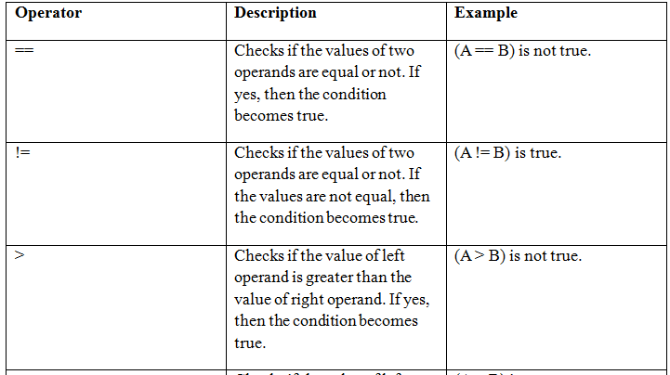
2. Relational Operators

Slide 26
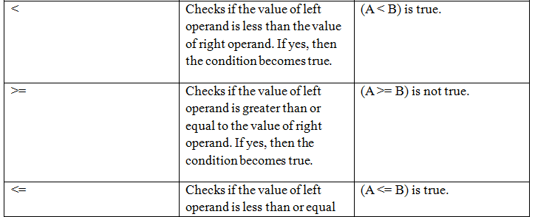

Relational Operators(cont..)

Slide 27
Relational Operators - Example
#include <stdio.h>
main()
{
int a = 21;
int b = 10;
int c ;
if( a == b )
{
printf("Line 1 - a is equal to b\n" );
}
else

Slide 28
Example(cont..)
{
printf("Line 1 - a is not equal to b\n" );
}
if ( a < b )
{
printf("Line 2 - a is less than b\n" );
}
else
{
printf("Line 2 - a is not less than b\n" );
}
if ( a > b )

Slide 29
Example(cont..)
{
printf("Line 3 - a is greater than b\n" );
}
else
{
printf("Line 3 - a is not greater than b\n" );
}
/* Lets change value of a and b */
a = 5;
b = 20;

Slide 30
Example(cont..)
if ( a <= b )
{
printf("Line 4 - a is either less than or equal to b\n" );
}
if ( b >= a )
{
printf("Line 5 - b is either greater than or equal to b\n" );
}
}

Slide 31
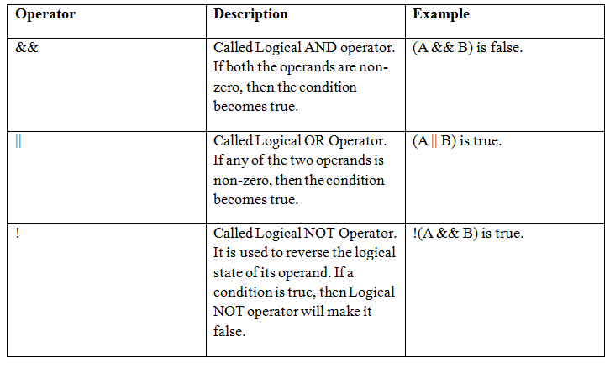
3. Logical Operators

Slide 32
Logical Operators – Example
#include <stdio.h>
main()
{
int a = 5;
int b = 20;
int c ;
if ( a && b )
{
printf("Line 1 - Condition is true\n" );
}
if ( a || b )
{

Slide 33
Example(cont..)
printf("Line 2 - Condition is true\n" );
}
/* lets change the value of a and b */
a = 0;
b = 10;
if ( a && b )
{
printf("Line 3 - Condition is true\n" );
}
else
{

Slide 34
Example(cont..)
printf("Line 3 - Condition is not true\n" );
}
if ( !(a && b) )
{
printf("Line 4 - Condition is true\n" );
}
}

Slide 35
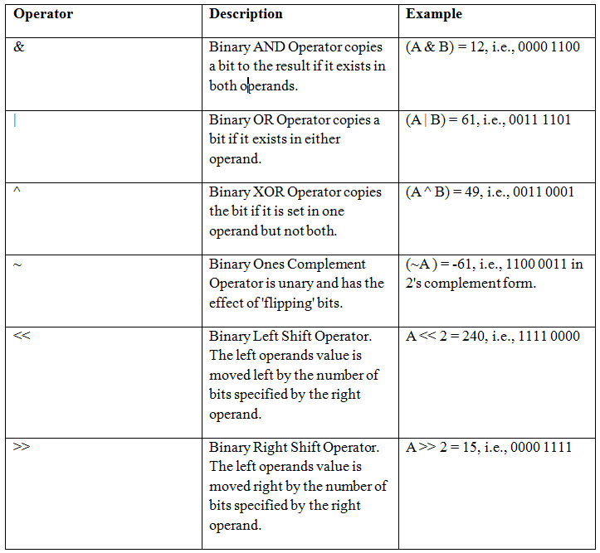
4. Bitwise Operators

Slide 36
Bitwise Operators - Example
#include <stdio.h>
main()
{
unsigned int a = 60; /* 60 = 0011 1100 */
unsigned int b = 13; /* 13 = 0000 1101 */
int c = 0;
c = a & b;
/* 12 = 0000 1100 */
printf("Line 1 - Value of c is %d\n", c );
c = a | b;
/* 61 = 0011 1101 */
printf("Line 2 - Value of c is %d\n", c );

Slide 37
Example(cont..)
c = a ^ b;
/* 49 = 0011 0001 */
printf("Line 3 - Value of c is %d\n", c );
c = ~a;
/*-61 = 1100 0011 */
printf("Line 4 - Value of c is %d\n", c );
c = a << 2;
/* 240 = 1111 0000 */
printf("Line 5 - Value of c is %d\n", c );
c = a >> 2;
/* 15 = 0000 1111 */
printf("Line 6 - Value of c is %d\n", c );
}

Slide 38
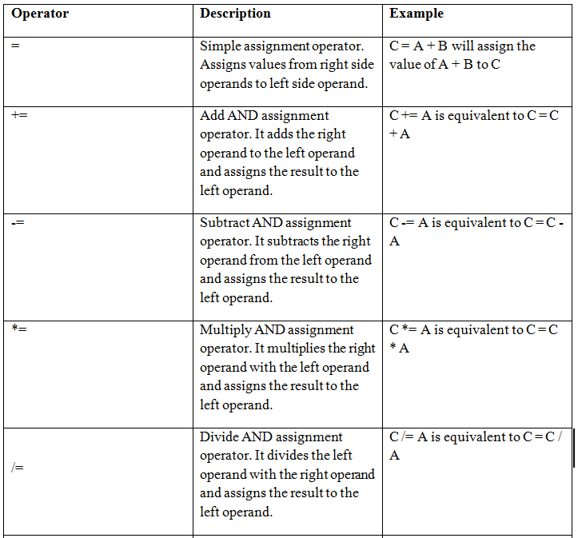
5. Assignment Operators

Slide 39
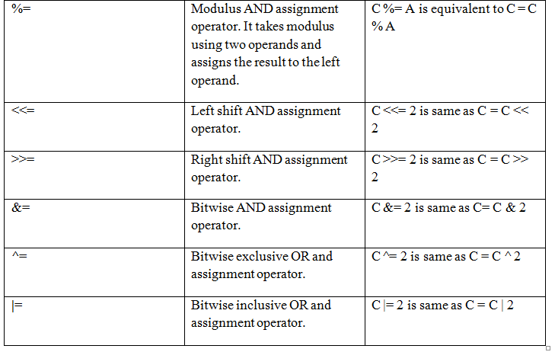
Assignment Operators(cont..)

Slide 40
Assignment Operators - Example
#include <stdio.h>
main()
{
int a = 21;
int c ;
c =a;
printf("Line 1 - =c +=Operator Example, Value of c = %d\n", c );
c+=a;
printf("Line 2 - += Operator Example, Value of c = %d\n", c );
c -= a;

Slide 41
Example(cont..)
printf("Line 3 - -= Operator Example, Value of c = %d\n", c );
c *= a;
printf("Line 4 - *= Operator Example, Value of c = %d\n", c );
c /= a;
printf("Line 5 - /= Operator Example, Value of c = %d\n", c );
c = 200;
c %= a;

Slide 42
Example(cont..)
printf("Line 6 - %= Operator Example, Value of c = %d\n", c );
c <<= 2;
printf("Line 7 - <<= Operator Example, Value of c = %d\n", c );
c >>= 2;
printf("Line 8 - >>= Operator Example, Value of c = %d\n", c );
c &= 2;
printf("Line 9 - &= Operator Example, Value of c = %d\n", c );
c ^= 2;

Slide 43
Example(cont..)
printf("Line 10 - ^= Operator Example, Value of c = %d\n", c );
c |= 2;
printf("Line 11 - |= Operator Example, Value of c = %d\n", c );
}

Slide 44
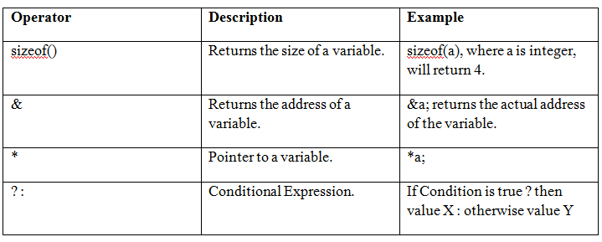
6. Misc Operators

Slide 45
Misc Operators - Example
#include <stdio.h>
main()
{
int a = 4;
short int b;
double c;
int* ptr;
/* example of sizeof operator */
printf("Line 1 - Size of variable a = %d\n", sizeof(a) );
printf("Line 2 - Size of variable b = %d\n", sizeof(b) );

Slide 46
Example(cont..)
printf("Line 3 - Size of variable c= %d\n", sizeof(c) );
/* example of & and * operators */
ptr = &a;
/* 'ptr' now contains the address of 'a'*/
printf("value of a is
%d\n", a);
printf("*ptr is %d.\n", *ptr);
/* example of ternary operator */
a = 10;
b = (a == 1) ? 20: 30;

Slide 47
Example(cont..)
printf( "Value of b is %d\n", b );
b = (a == 10) ? 20: 30;
printf( "Value of b is %d\n", b );
}

Slide 48
THANK YOU…

